Slide 1

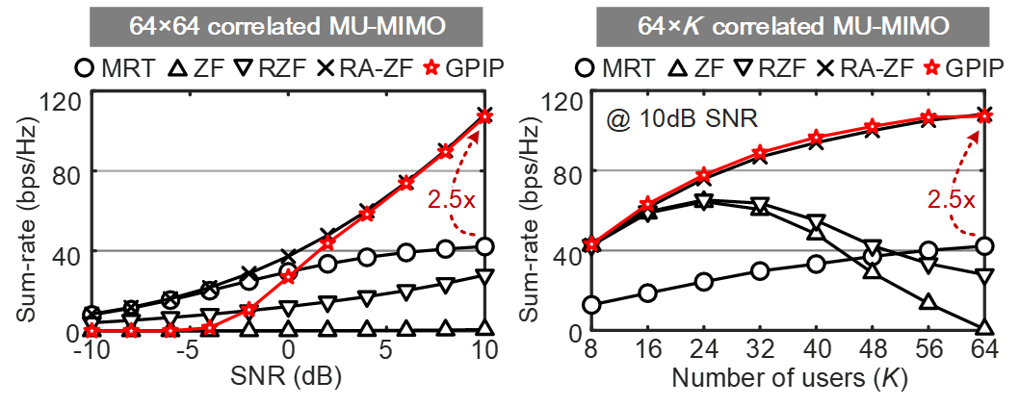
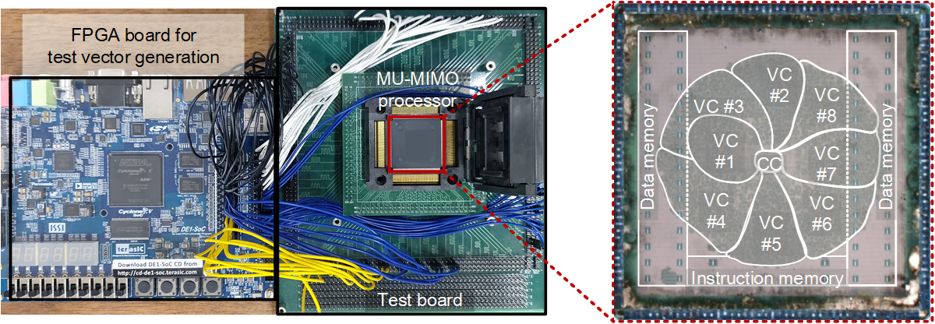
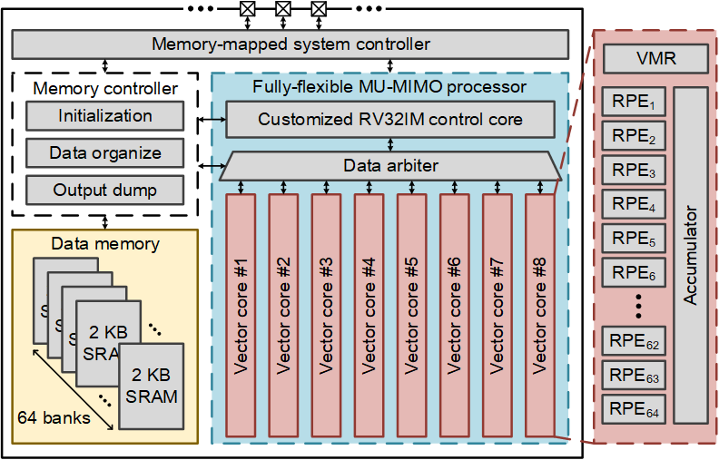
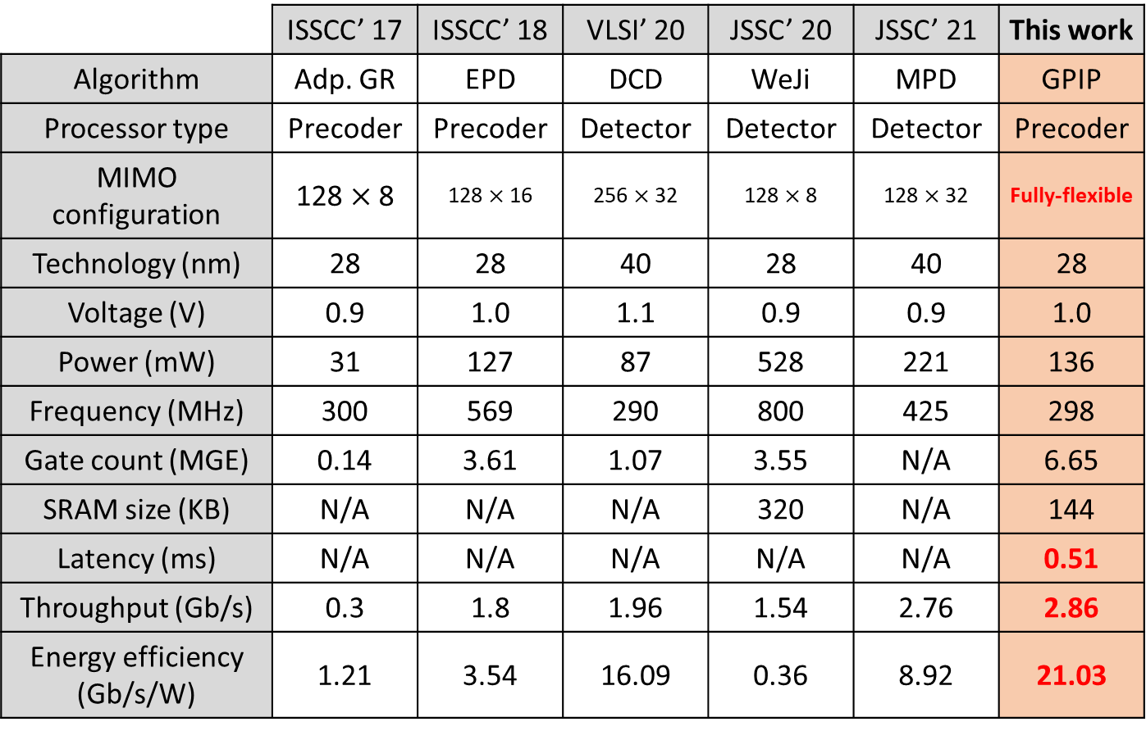
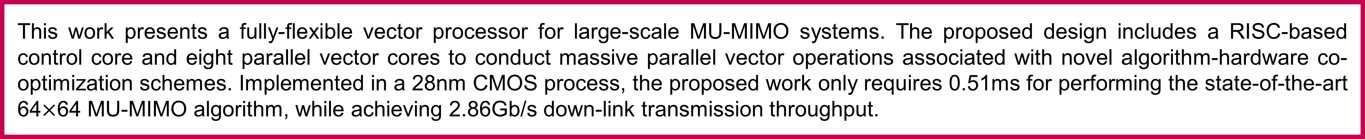
A 2.86Gb/s Fully-Flexible MU-MIMO Processor for Jointly Optimizing User Selection, Power Allocation, and Precoding in 28nm CMOS Technology
Seungsik Moon and Youngjoo Lee
Department of Electrical Engineering, Pohang University of Science and Technology
Abstract
This work presents a fully-flexible vector processor for large-scale MU-MIMO systems. The proposed design includes a RISC-based control core and eight parallel vector cores to conduct massive parallel vector operations associated with novel algorithm-hardware co-optimization schemes. Implemented in a 28nm CMOS process, the proposed work only requires 0.51ms for performing the state-of-the-art 64$×$64 MU-MIMO algorithm, while achieving 2.86Gb/s down-link transmission throughput.
GPIP algorithm for large-scale MU-MIMO configuration
Implementation Results
Transmission quality with different algorithms
Die photograph and FPAG-based testing platform
Processing latency with the proposed processor
Comparison with state-of-the-art designs
Proposed design
Overall architecture of the proposed processor
Detailed architecture of the vector core

